Slide 1


Controlling the Unseen: Undergraduate Optical Research
Parker Landon
Mentor: Dr. Andri Gretarsson

Slide 2
A Big Thank You To:
Embry-Riddle’s Undergraduate Research Institute
And Arizona Space Grant Committees

Slide 3
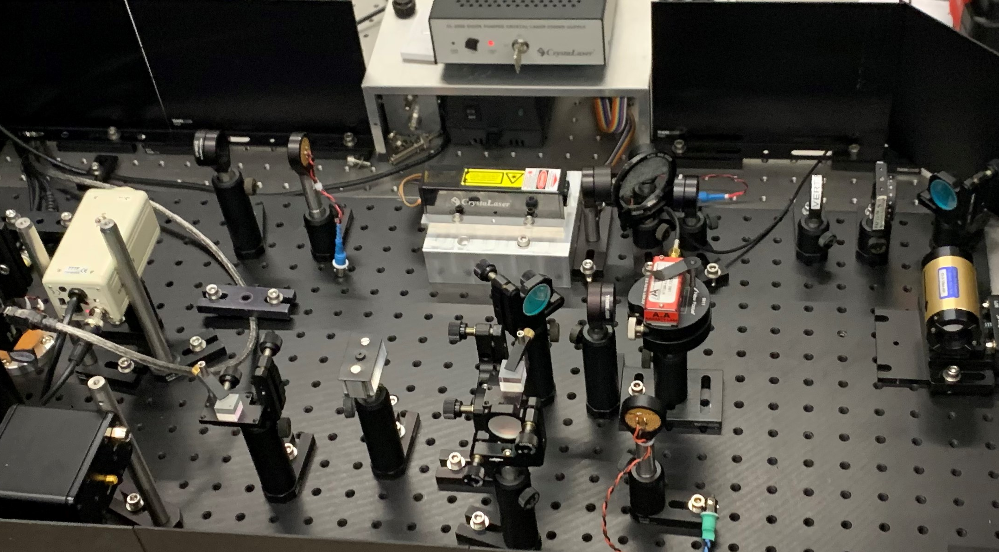
Summary
The Team
Interferometry
Our Goal
Control Systems
What I have Done
Where We Are Going
Conclusion

Slide 4
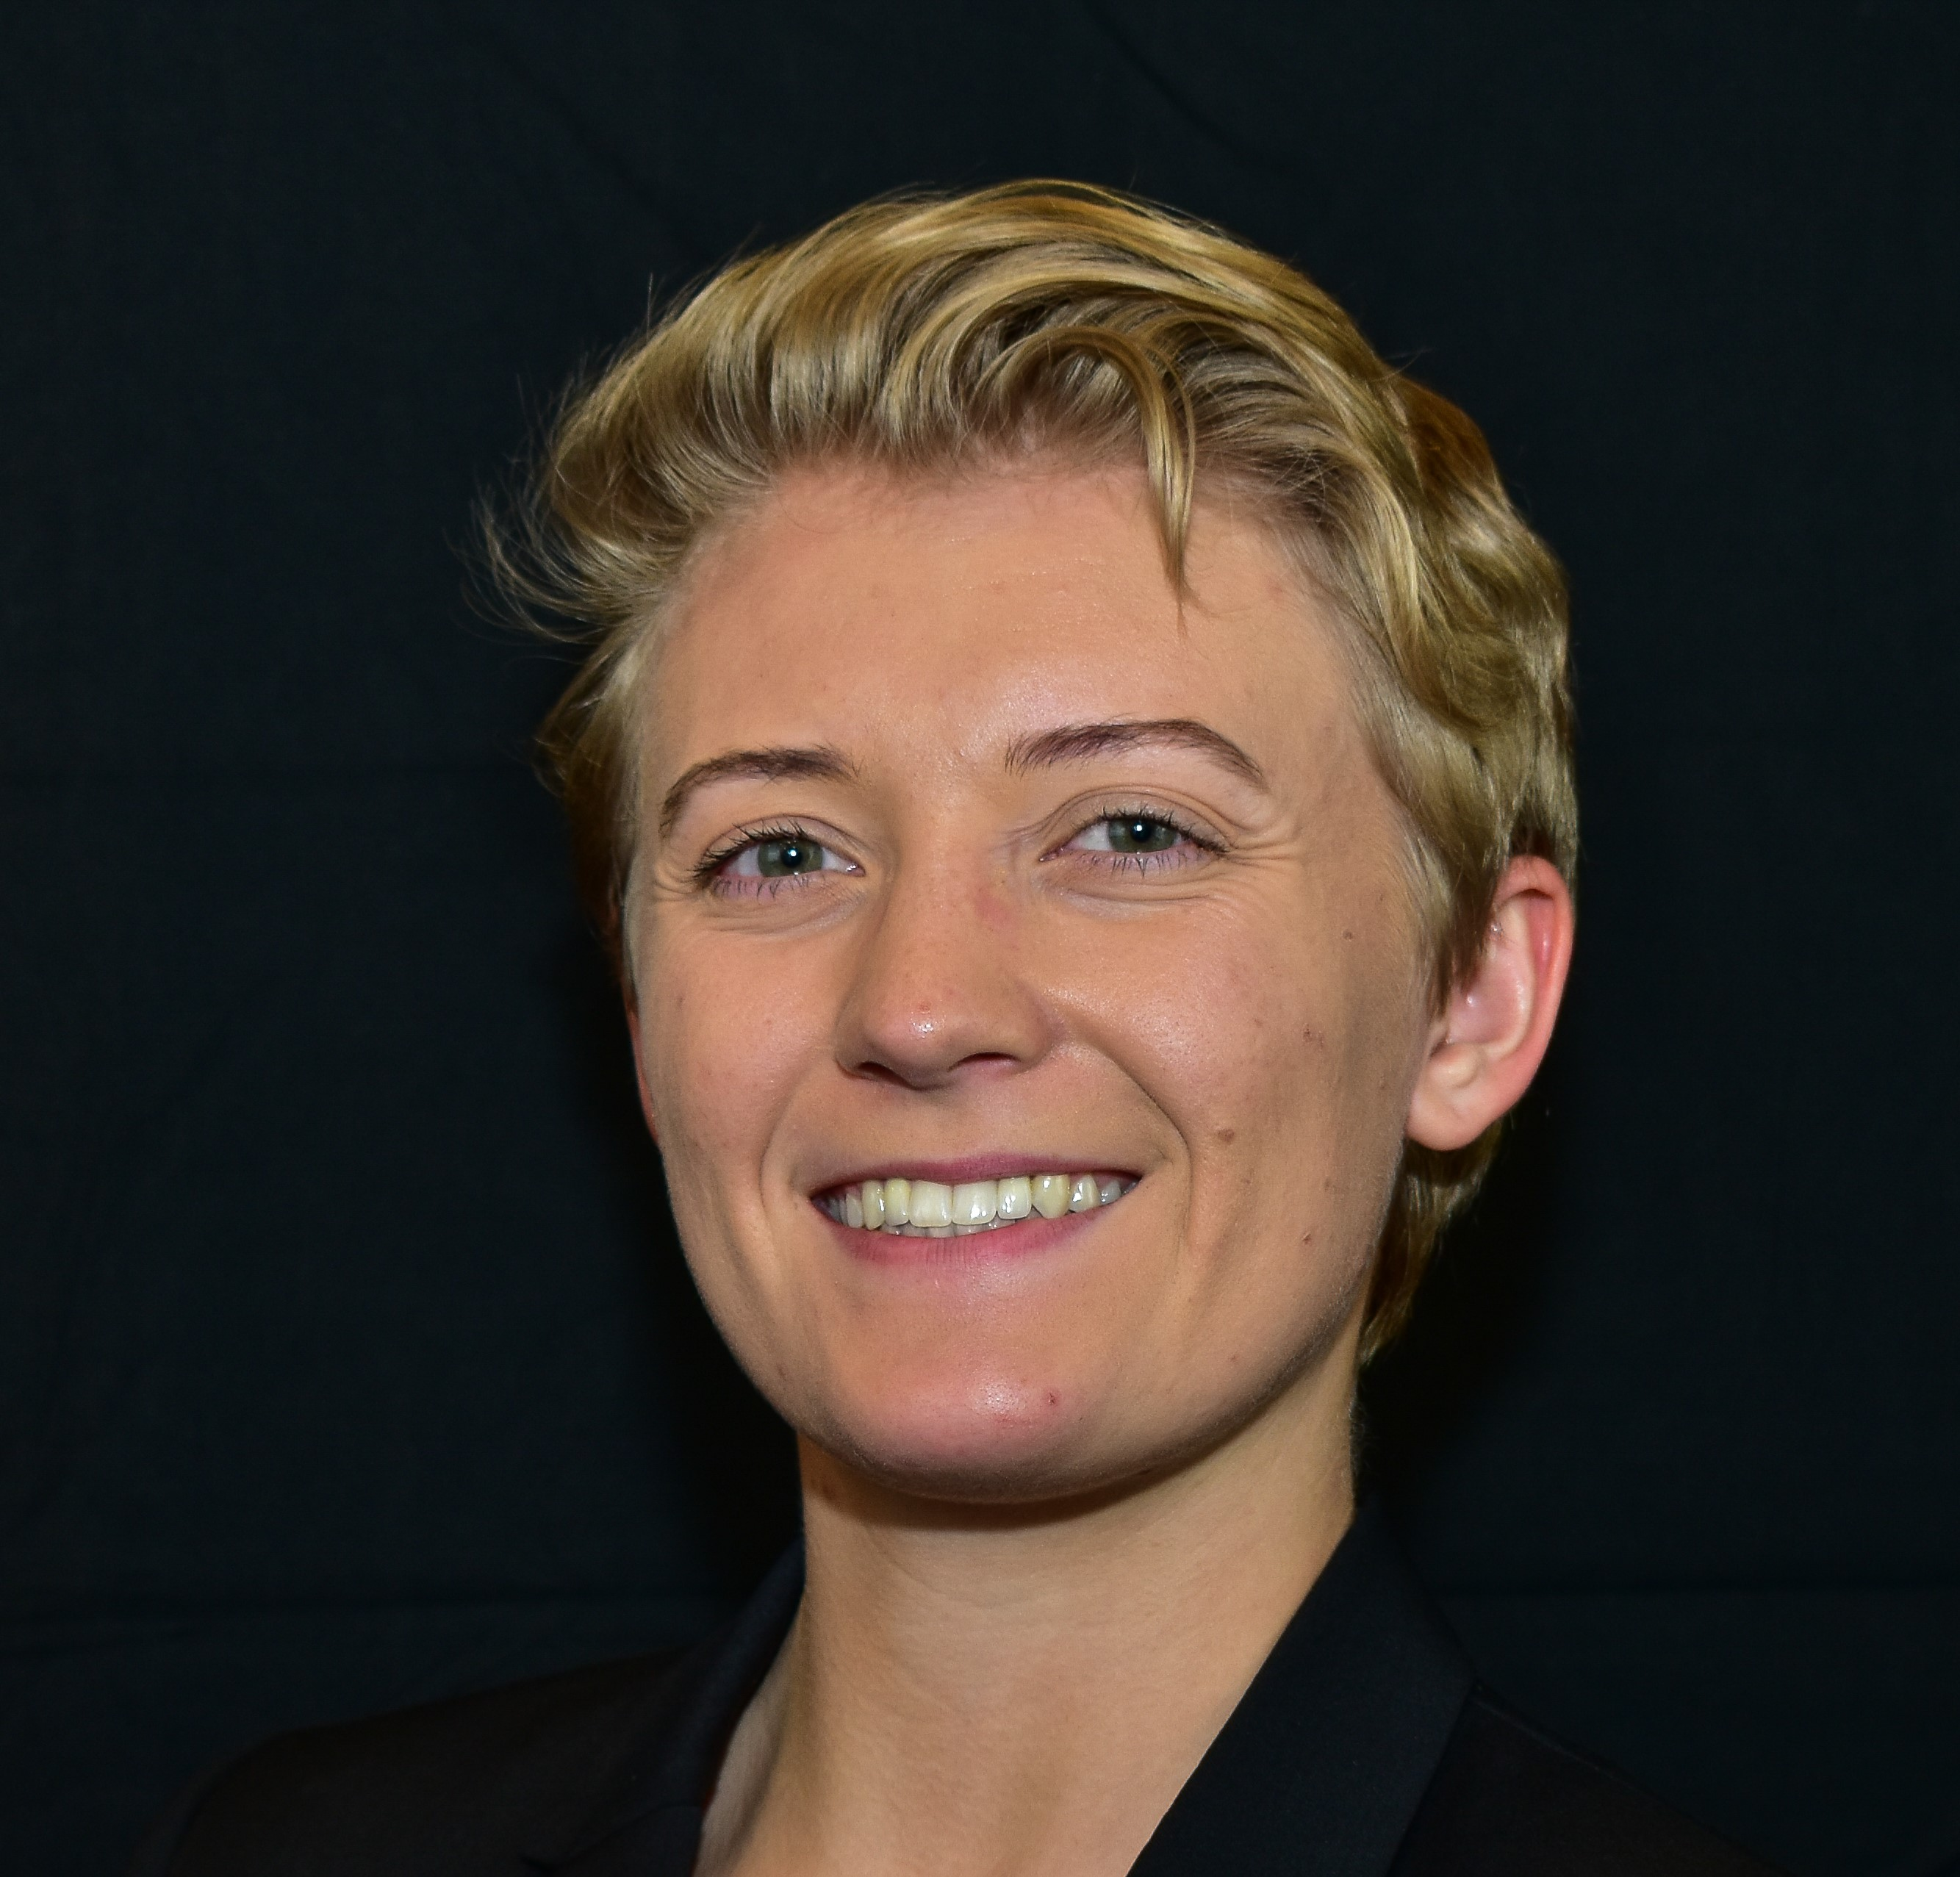
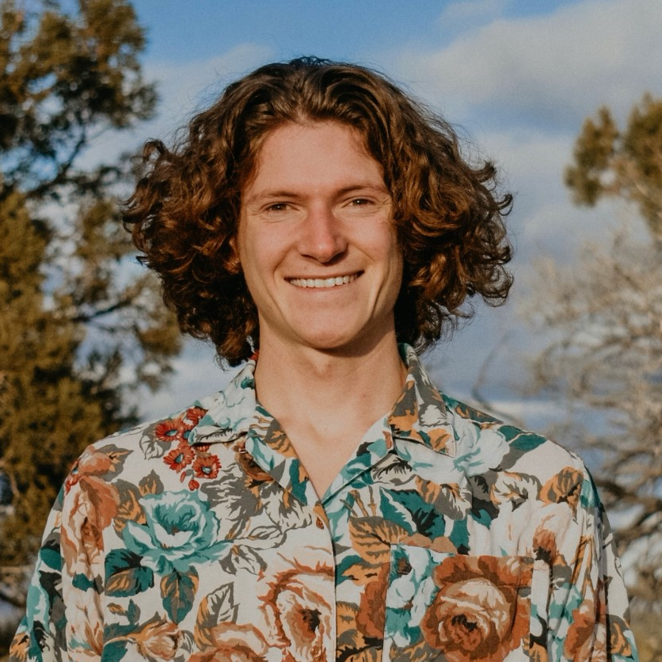
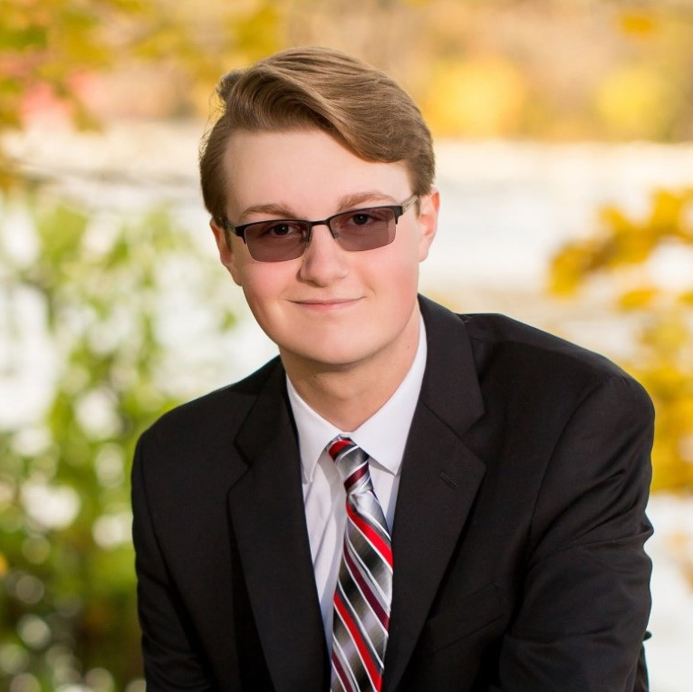
Meet the Team!
Parker Landon
Feedback Controls Lead – Computer Engineering & Space Physics Junior
Austin Luttrell
Optical Chain Lead – Space Physics Senior
Curtis Eggers
Optical/Software Integration Lead – Space Physics Junior

Slide 5
Interferometry And Its Advantages
1
Benefits of Multidiscipline Communication

Slide 6
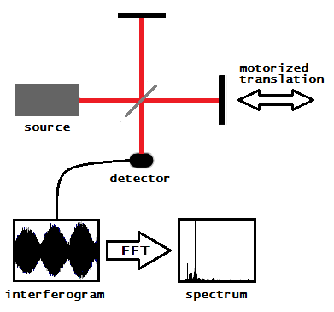
What is Interferometry?

Slide 7
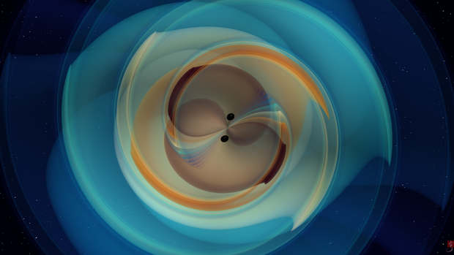
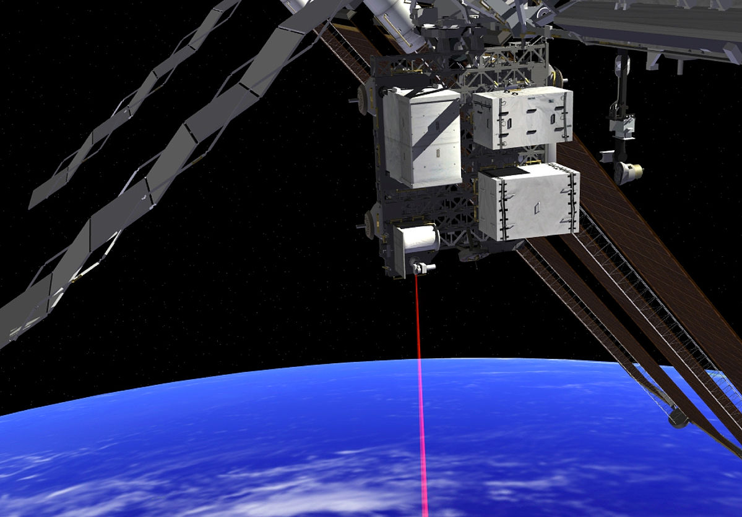
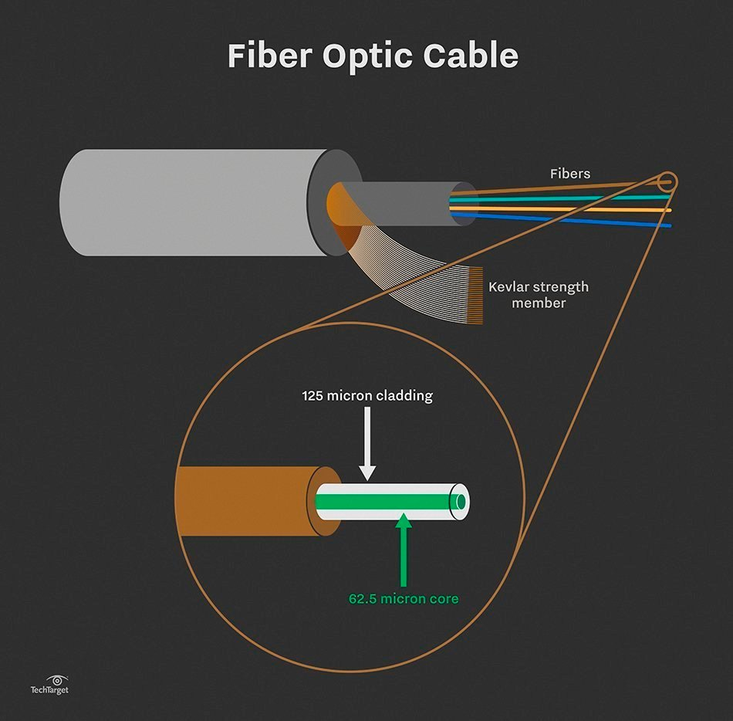
Where is Interferometry Used?

Slide 8
Project Goal
Undergraduates Doing Graduate Level Work

Slide 9
Control Systems Design and Analysis
2
Feedback and Root Locus

Slide 10
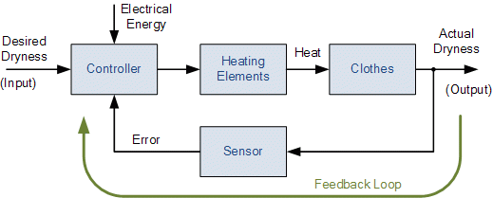
What is Feedback?

Slide 11

How to Control Feedback.

Slide 12
Current Control System
3
Amplitude Modulation Servo

Slide 13
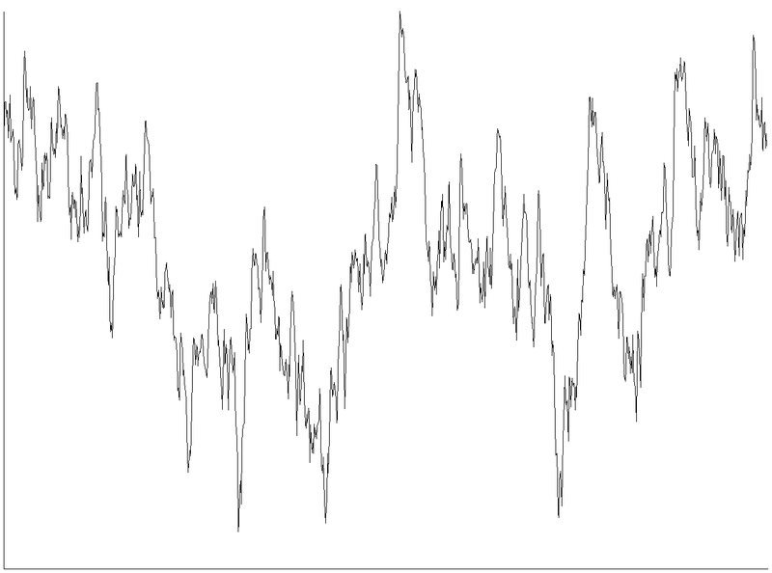
AM Servo System

Slide 14
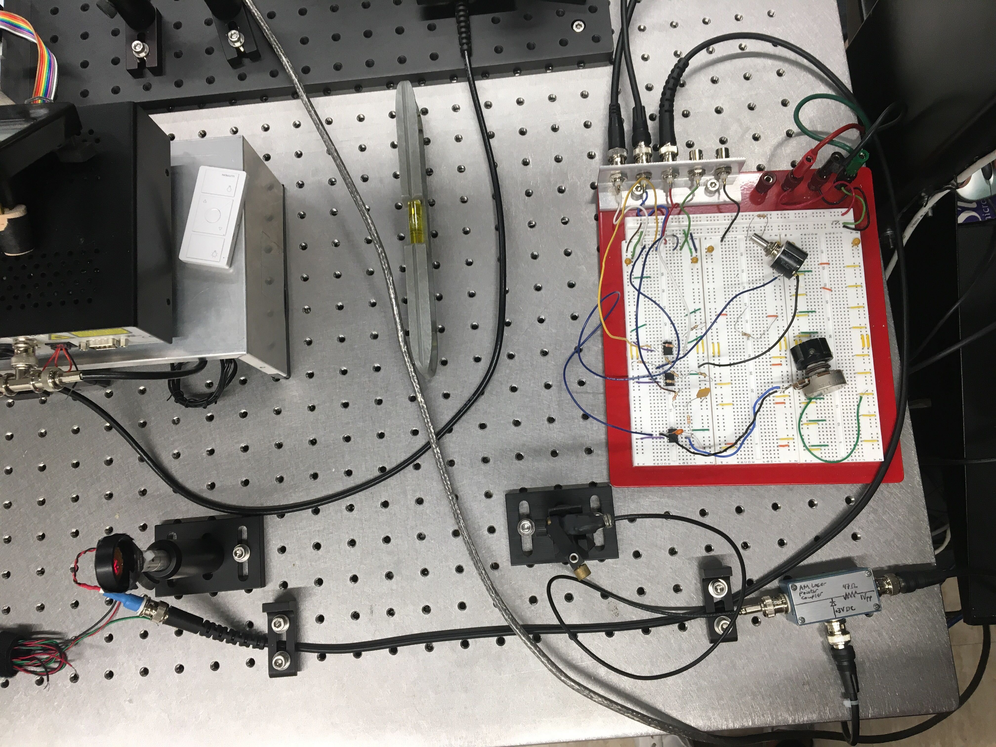
AM Servo System

Slide 15
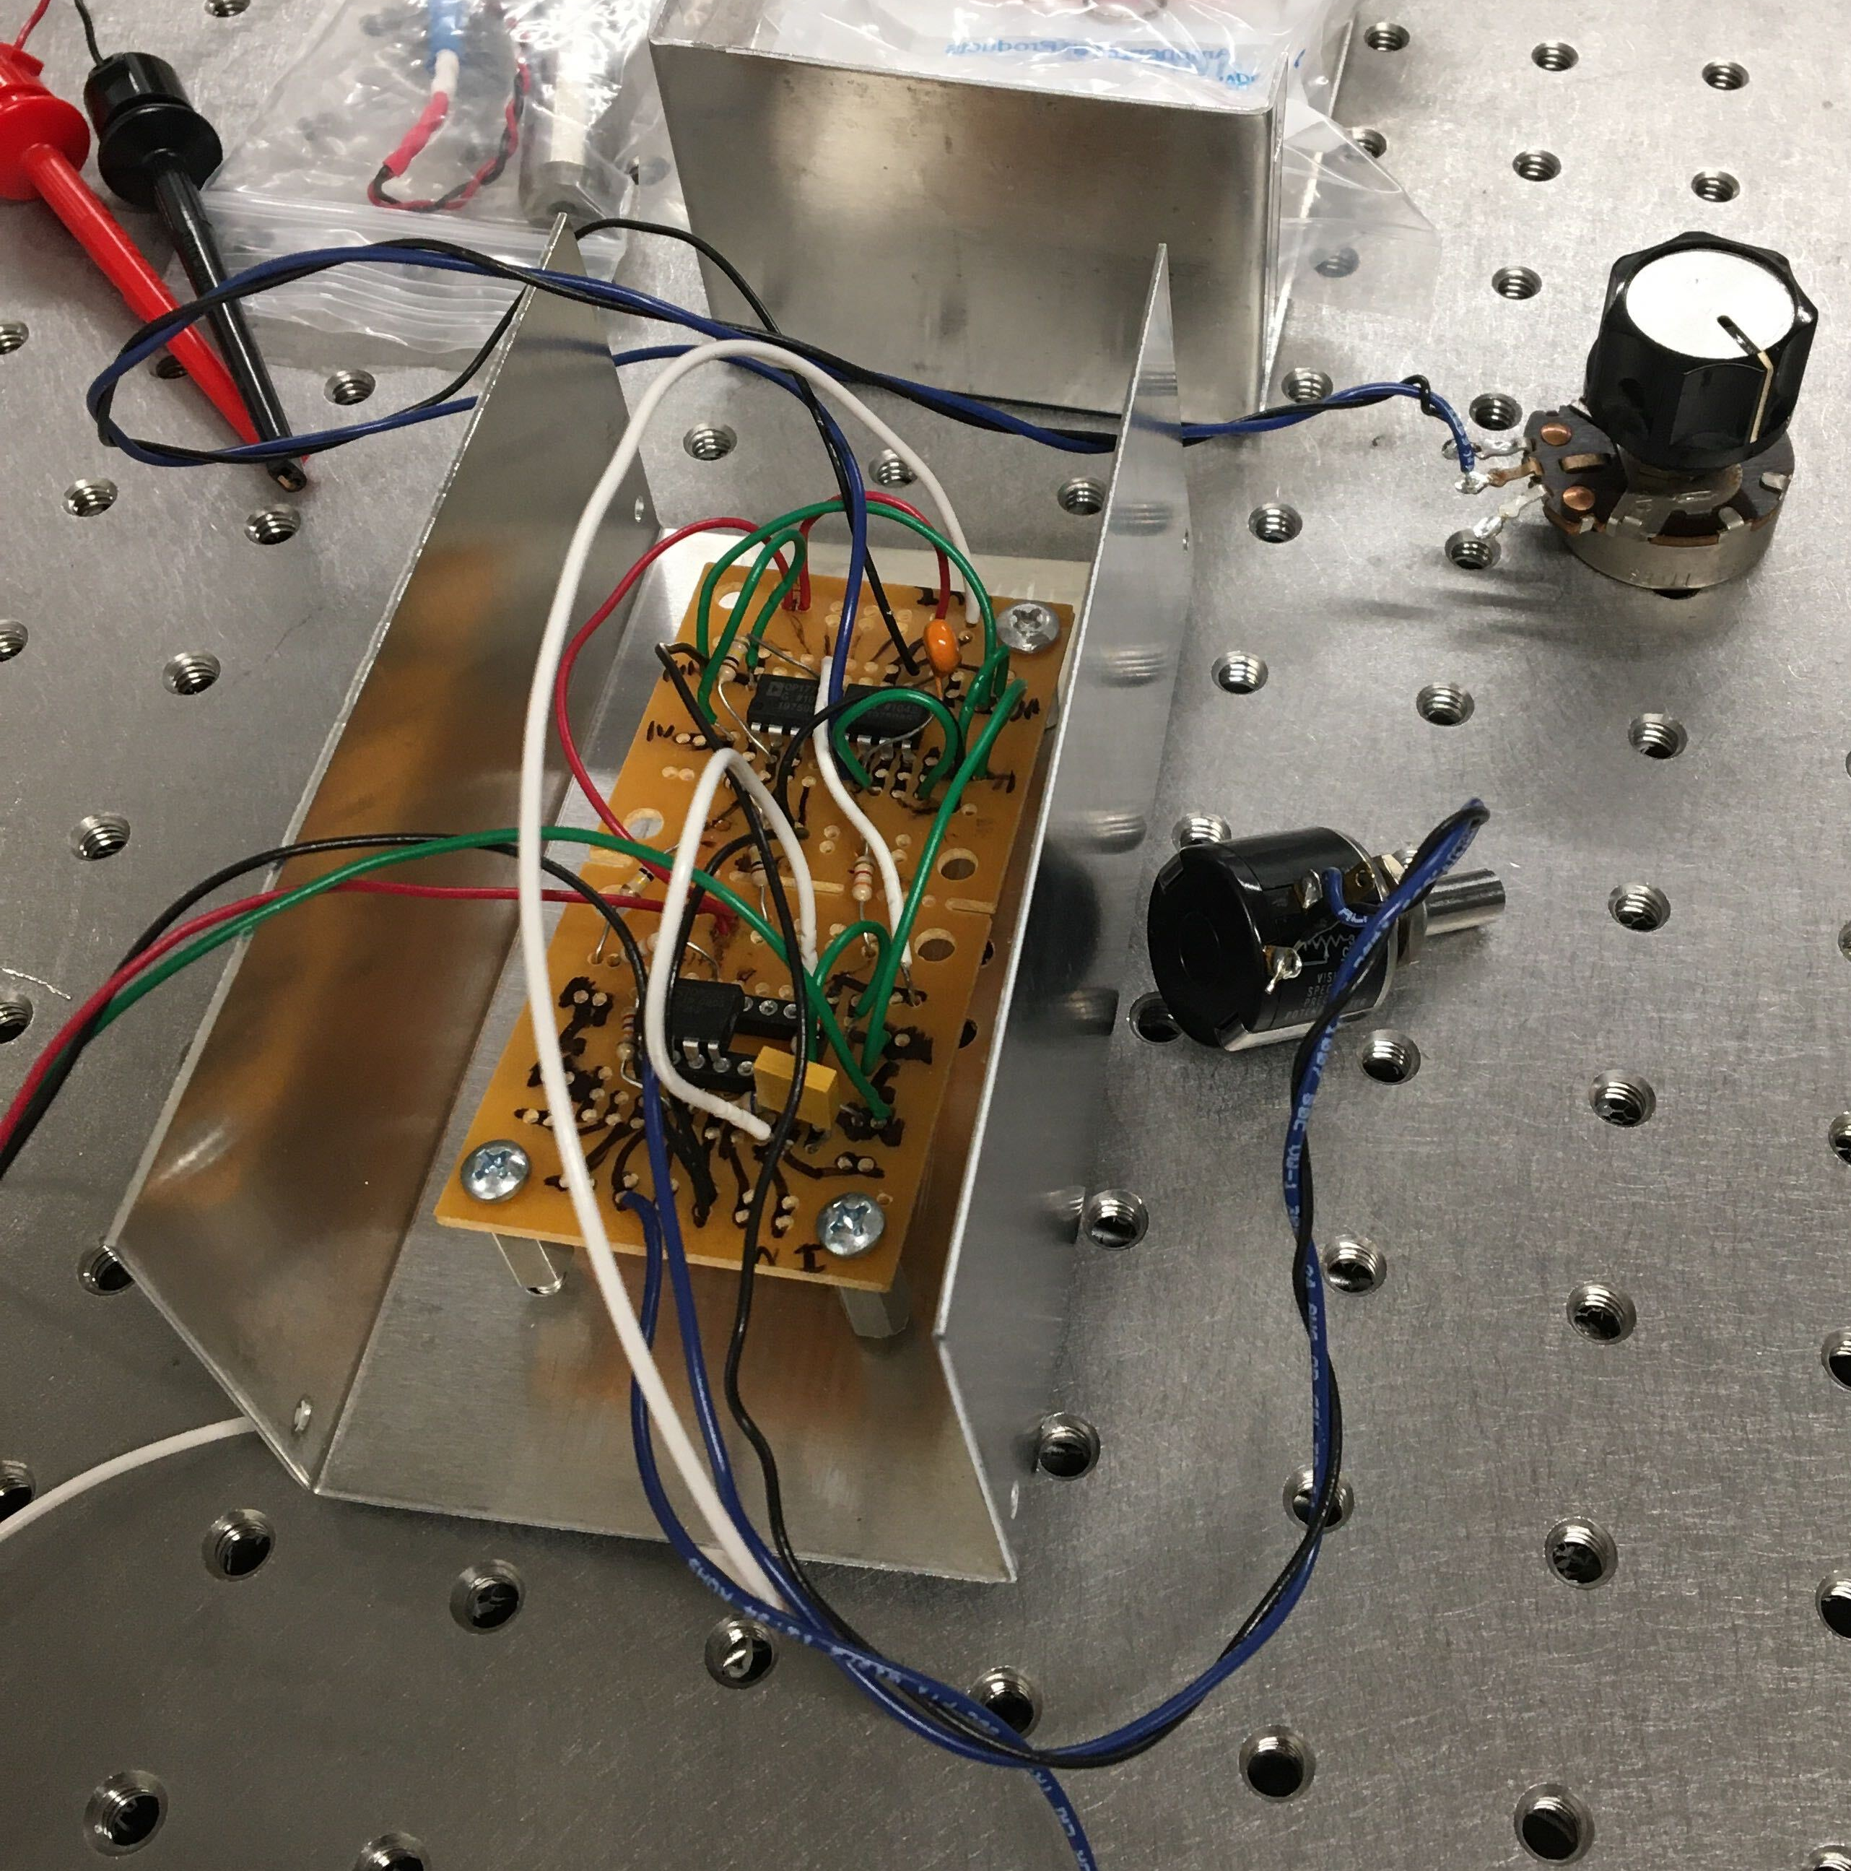
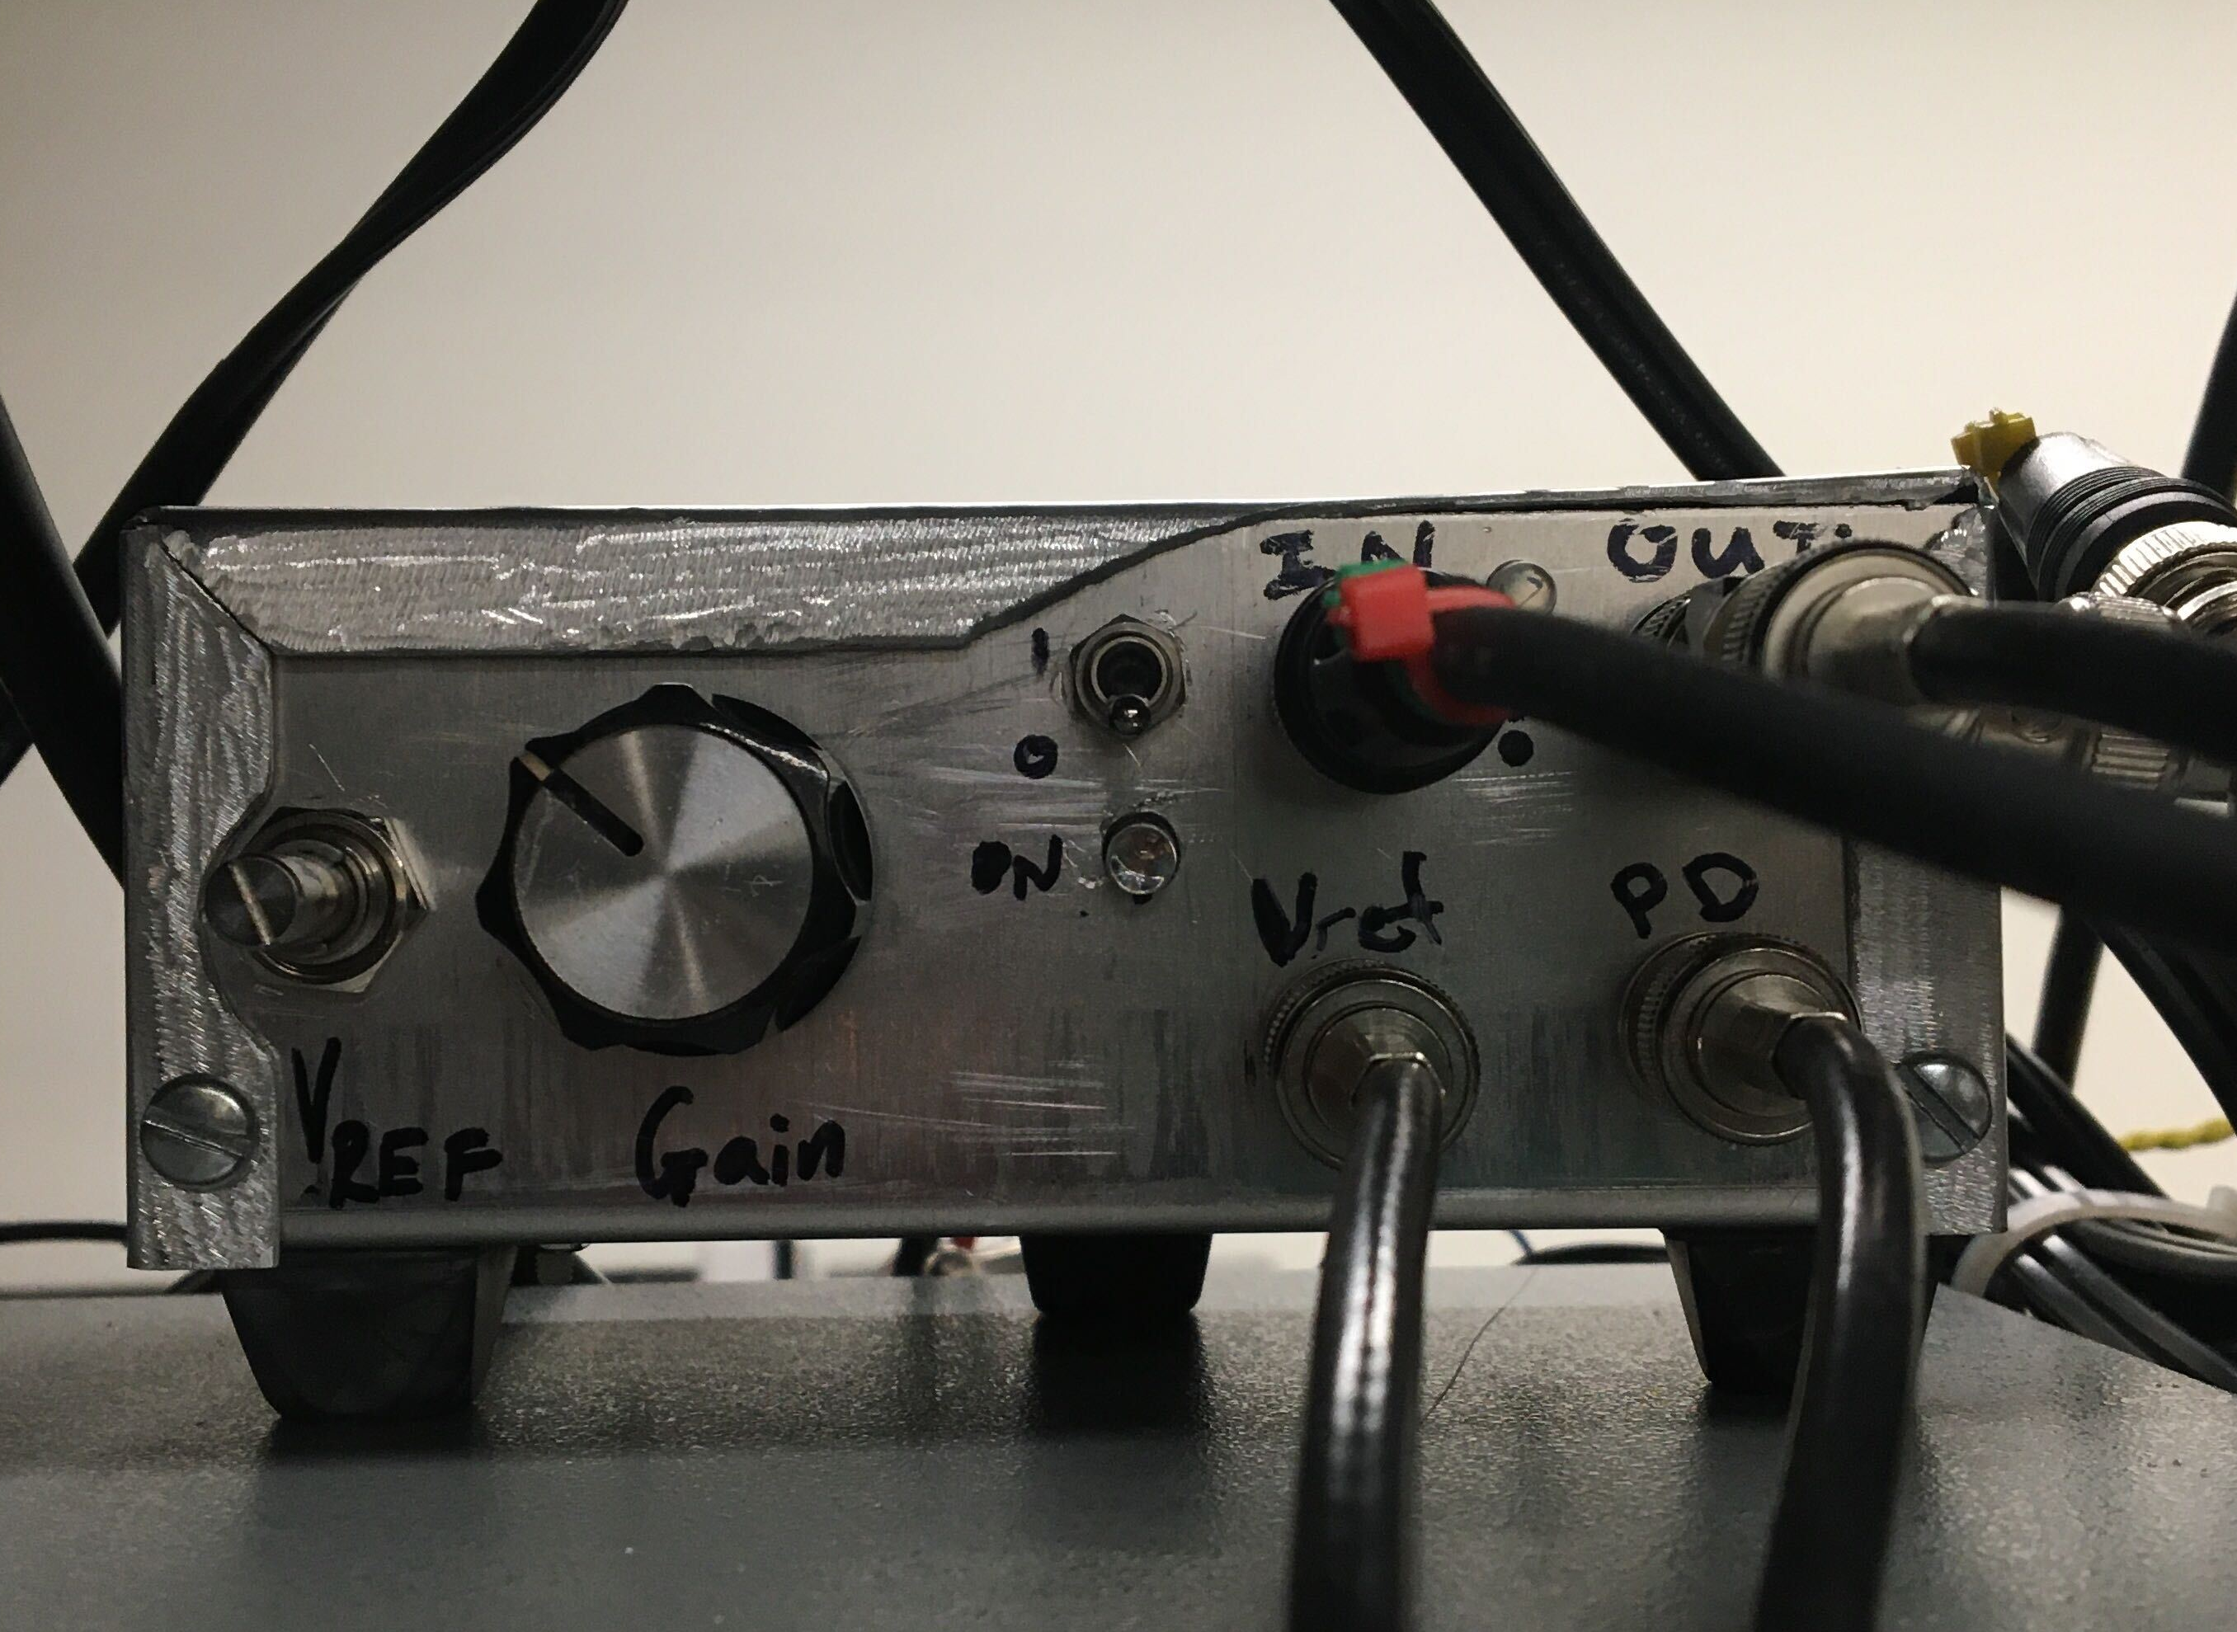
AM Servo System

Slide 16
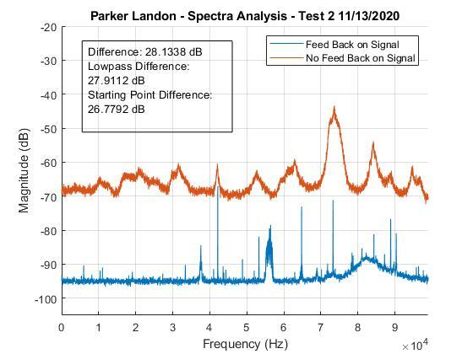
Amplitude Servo Closed Loop Response

Slide 17
Plans for the Future
Frequency Modulation Servo
Bode/Frequency Analysis
Full Closed Loop System Development

Slide 18
Thanks!
ANY QUESTIONS?
landonp@my.erau.edu

Slide 19
Sources/Citations
By Stigmatella aurantiaca at English Wikipedia, CC BY-SA 3.0, https://commons.wikimedia.org/w/index.php?curid=20216507
https://searchnetworking.techtarget.com/definition/fiber-optics-optical-fiber
https://web.archive.org/web/20140813041900/http://www.jpl.nasa.gov/news/news.php?release=2013-218
https://www.electronics-tutorials.ws/systems/closed-loop-system.html
https://commons.wikimedia.org/wiki/File:Pink.noise.png

